Slide 1

Exploring the Correlation between Pediatric Healthcare Outcomes and Socioeconomic variables using KID’s Inpatient Data​​ ​
BSAN 710: Business Analytics Capstone Project
Team 1

Slide 2






Team Members
VISUALIZATION
ANALYST
PROJECT MANAGEMENT
SAHANA KUMAR
YASH GUPTA
PURVI PANCHAL
CODING
VISUALIZATION
LITERATURE REVIEW
PRIYAL DESAI
NIRJHARA SINGH
TAHA TALWALA

Slide 3




Executive Summary
Effects of Socio-Economic Factors on Alcohol and Substance Abuse in children
Correlation of Socio-Economic Factors on Neonatal Deaths
Females are charged more in alcohol abuse treatments on average than males.​
Charges for Medicaid are higher compared to private ​.
​Private owned Investor hospitals are charging lesser than non-profits.
Being underweight followed by Respiratory Issues are the most prevalent issues for neonatal deaths.
Asian and Pacifics paying higher than others even though they are having less population.
Patients from the median income bracket of 61,000-81,999 have the highest average charges in south.
​
Subsidized Care for female child
​
Stricter tobacco policies for pregnant women.​
Streamlining medical billing processes to save ~ $500 Billion and fostering public-private insurance collaboration to increase Medicaid acceptance among providers, thereby improving neonatal and substance abuse outcomes.

Slide 4
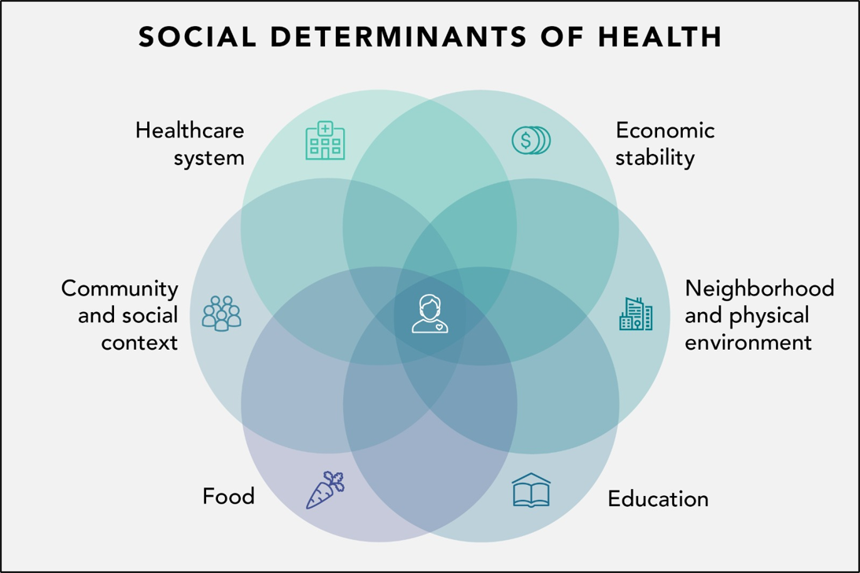
Business Questions
Effects of Socio-Economic Factors on Alcohol and Substance Abuse in children
Correlation of Socio-Economic Factors on Neonatal Deaths
Socio Economic Factors Include:
Race
Region
Income
Gender
Age
https://healthinfo.montana.edu/cheg/health-equity/index.html​
Caution: The following slides may contain sensitive content. Viewer discretion is advised.​

Slide 5
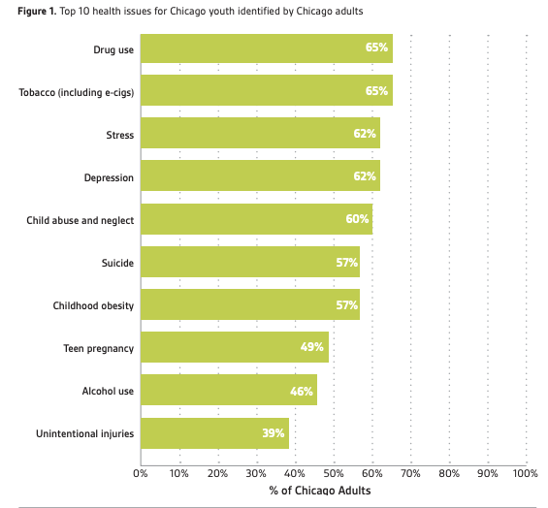
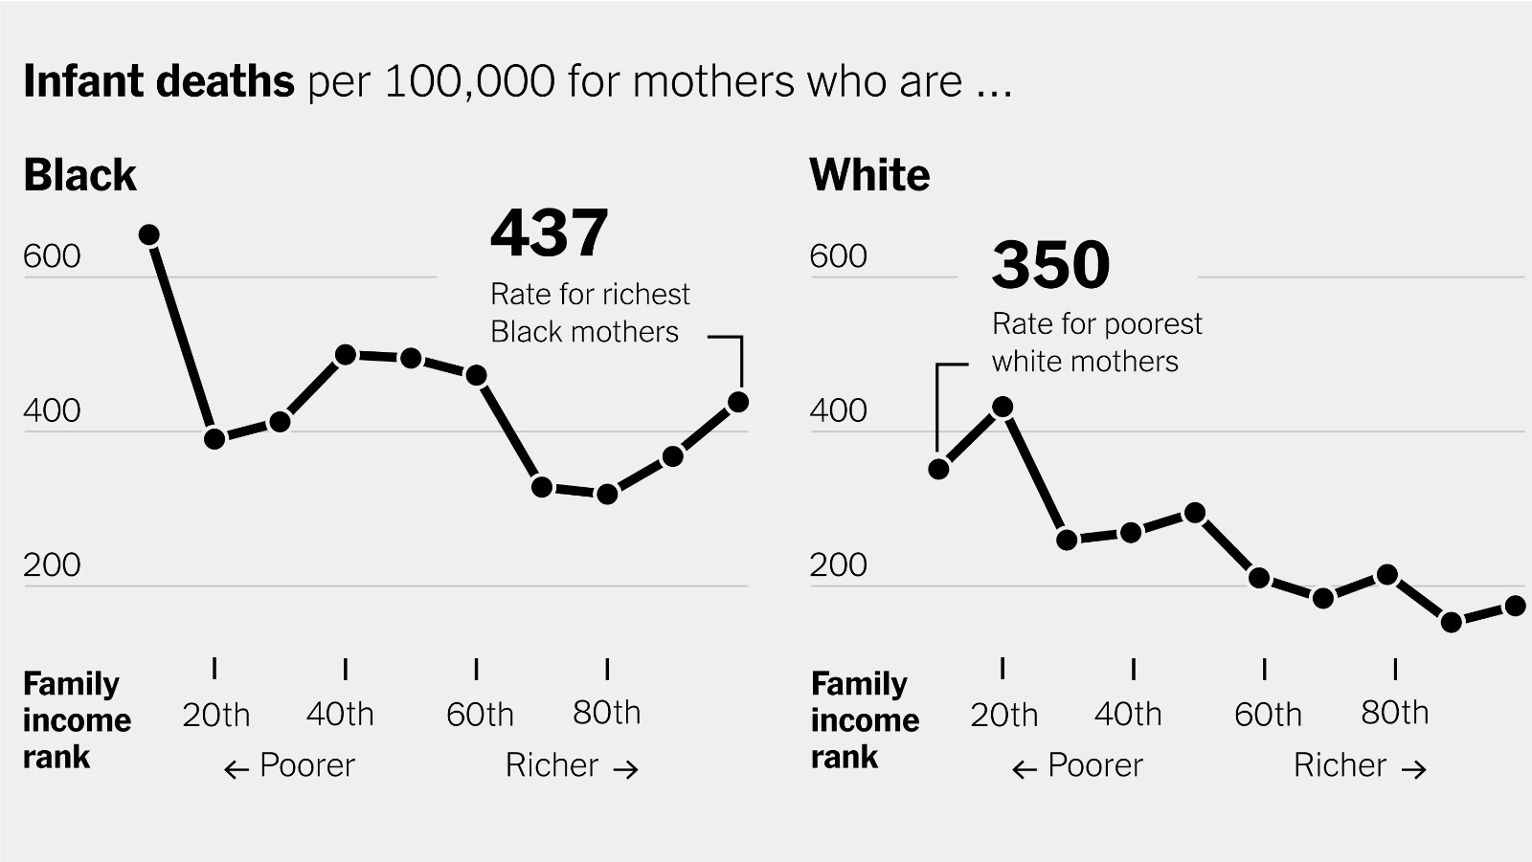
Motivation
https://www.luriechildrens.org/en/voices-of-child-health-in-chicago/top-10-youth-non-covid-19-health-problems/
https://www.nytimes.com/interactive/2023/02/12/upshot/child-maternal-mortality-rich-poor.html
Caution: The following slides may contain sensitive content. Viewer discretion is advised.​

Slide 6
Chi Squared, Kruskal Wallis, and Dunn's Test
CHI SQUARED TEST
Chi Squared Test used to identify relation between Socio Economic Factors on research variable.
KRUSKAL WALLIS AND DUNN’S TEST​
Kruskal Wallis Test used to test difference in charges across Regions and Races.
Dunn's Test is a post-hoc procedure to identify which specific groups differ.
We reject Null Hypothesis for both tests, indicating -
Significant relation between each socioeconomic factor and target variables.
significant difference in the average total charges between the different hospital regions and races.

Slide 7
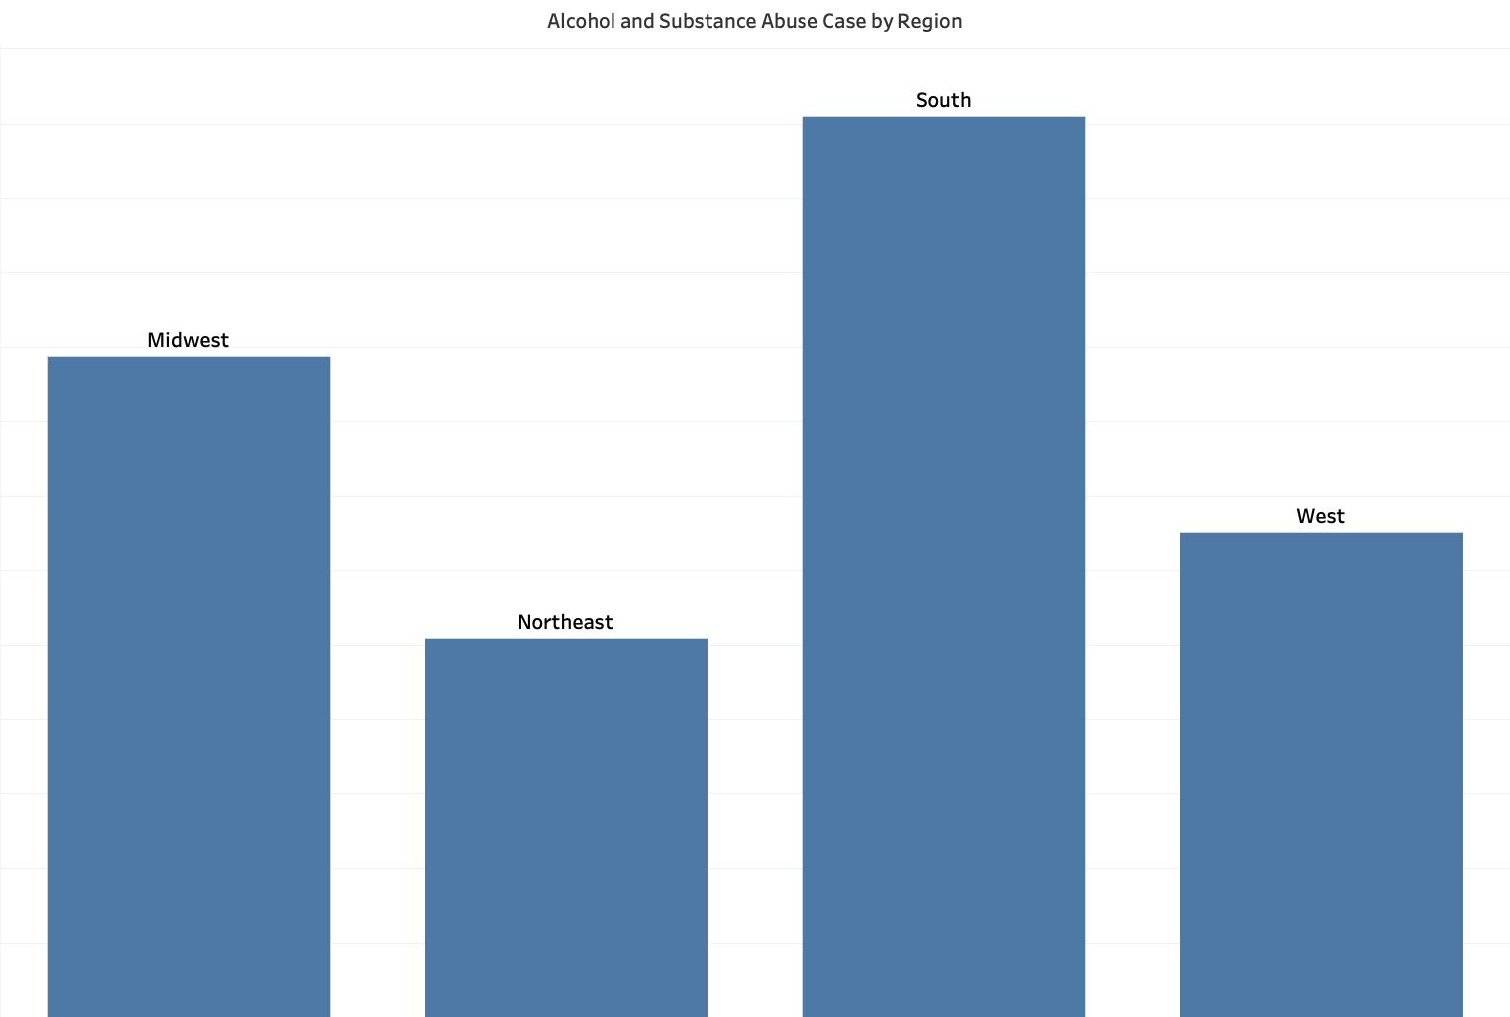
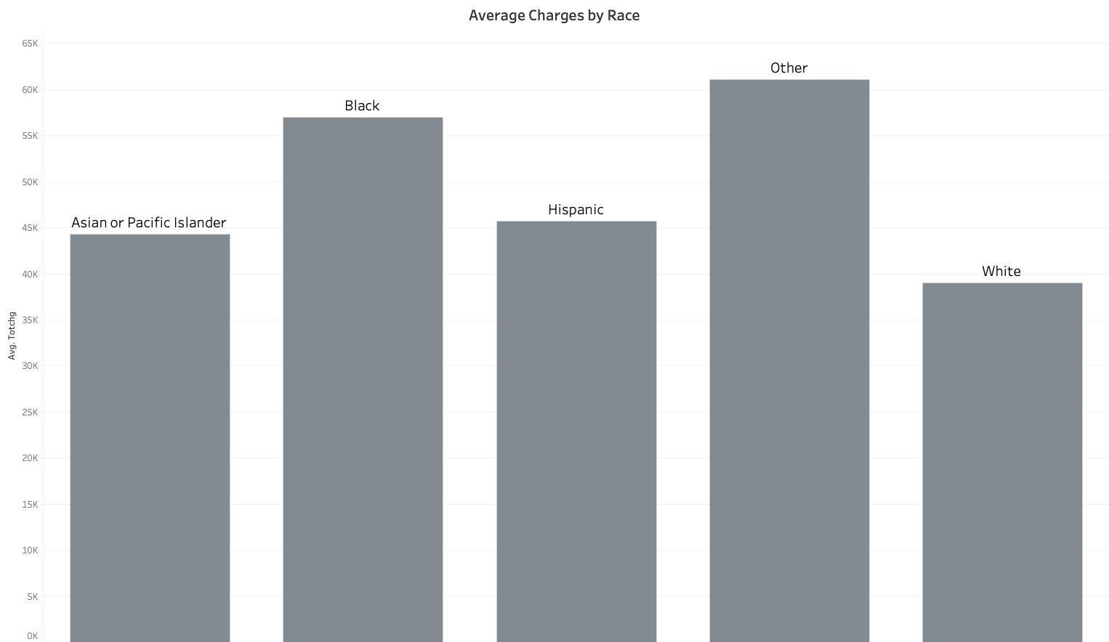
Hypothesis Output for Alcohol & Substance Abuse
Dunn's Test Results for Alcohol & Substance Abuse
Northeast vs. West: No significant differences.
Average Charges different for all other regional combinations.
Asian or Pacific Islander vs Hispanic: No significant difference in average charges.
Asian or Pacific Islander vs Black: No significant difference in average charges.
Average Charges different for all other racial combinations.

Slide 8
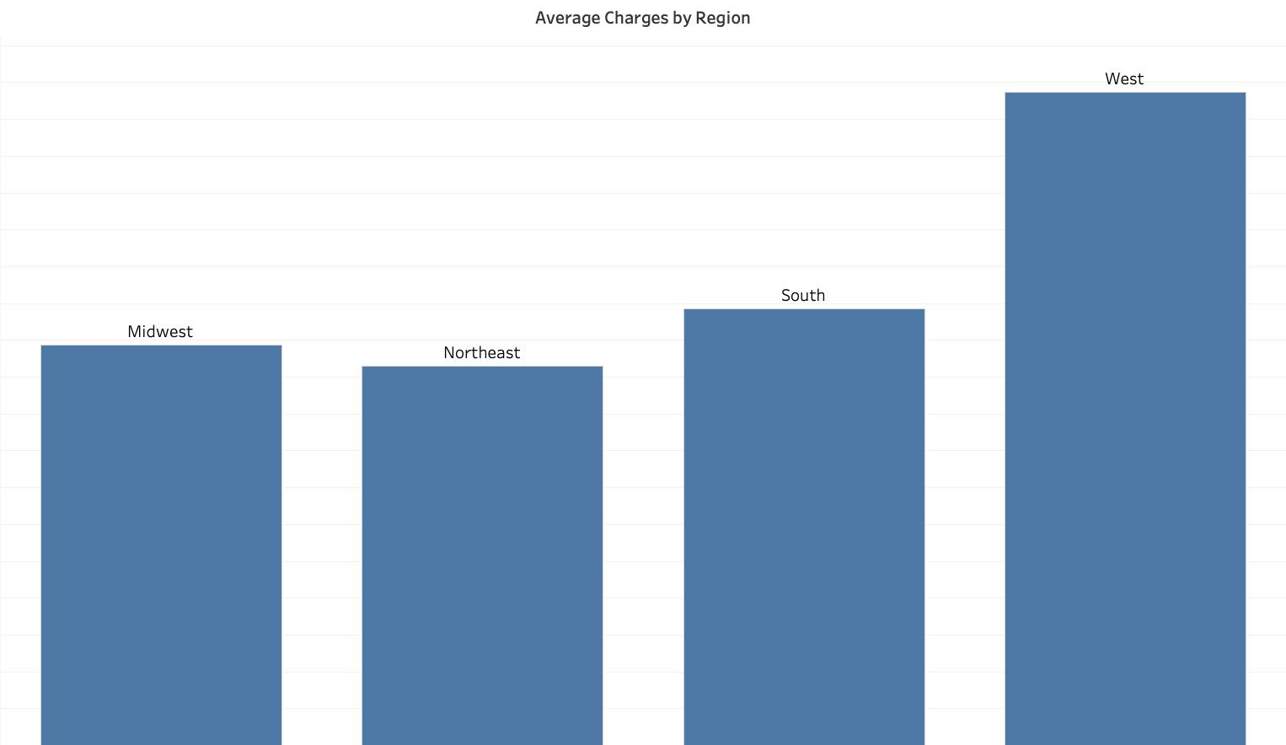
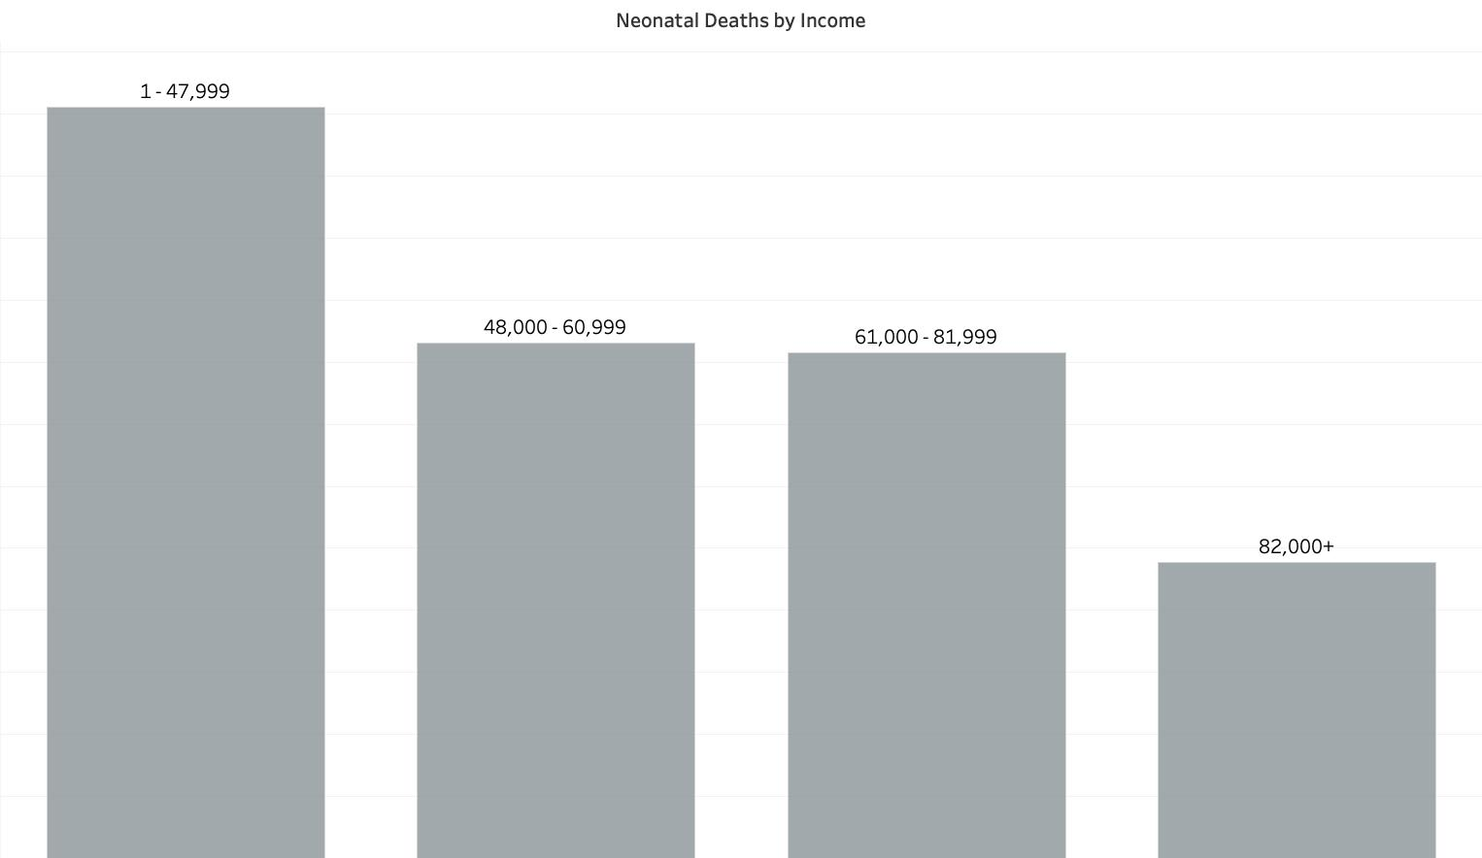
Hypothesis Output for Neonatal Death
Dunn's Test Results for Neonatal Death
Northeast vs. South: No significant differences in average charges.
Northeast vs. Midwest: No significant differences in average charges.
Average Charges different for all other regional combinations.
White vs. Other Races: No significant differences in average charges.
Asian or Pacific Islander vs. Other Races: No significant differences in average charges.
Average Charges different for all other racial combinations.

Slide 9
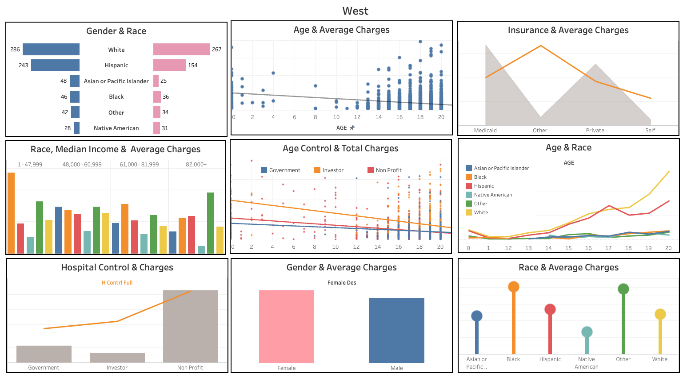
Insights from Regional Analysis: Alcohol & Substance Abuse
Average Cost decreasing by Age.
Females on average are charged higher for services compared to Men.
In lower income brackets, Blacks and Asian & Pacific Islanders are being charged the most compared to other races.
Medicaid & Private Insurance cost almost similar.
‘Private Non-profit’ Hospitals cost more than ‘Private Investor Owned’ Hospitals.

Slide 10
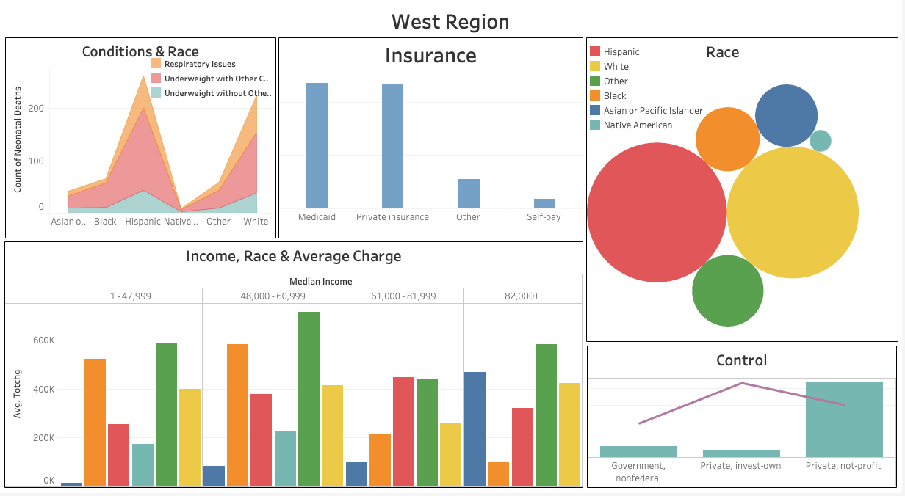
Insights from Regional Analysis: Neonatal Deaths
Whites and Hispanics show higher instances of Respiratory Issues and Underweight Infants.
Almost similar count of deaths for those who opt for Medicaid vs Private Insurance.
Higher Death neonatal death count for Hispanics and White as compared to other races.
In lower income brackets, Blacks are charged higher on average compared to other races.

Slide 11
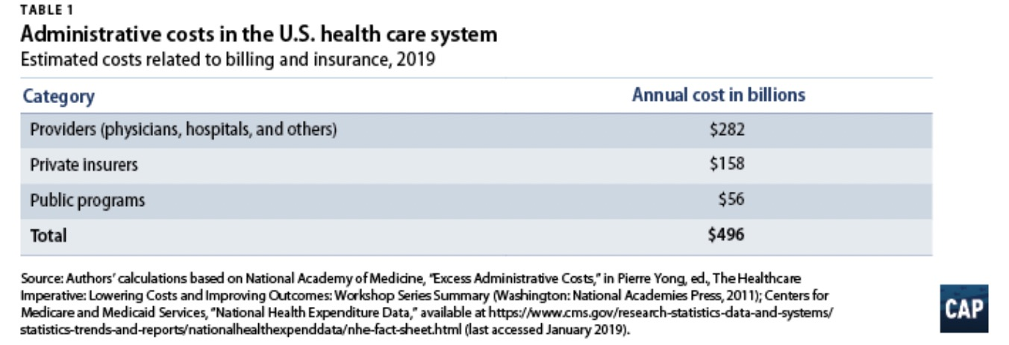
Streamlining Billing and Insurance Related Activities (BIR)
BIR constitutes- 12.3% on private insurance; and 3.5% on public program in 2010
Estimated BIR costs $496 billion for 2019
2019 estimates- $158 billion in overhead for private insurance; $56 billion for administration of public insurance programs
Moreover, 19% less hospitals prefer Medicaid to Private Insurance due to Billing Related Issues.
Streamlining Billing Process Benefits:
Could reduce the administrative costs to approximately 12% of revenues from 25%.
Will address the around $504 billion excess cost in $1.1 trillion currently spent on health care administration
Notes:
https://www.vox.com/2021/6/7/22522479/medicaid-health-insurance-doctors-billing-research

Slide 12
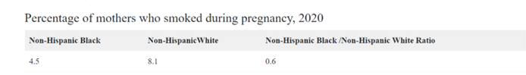
NICU related to Neonatal Health Care Cost
Maternal smoking is related to nearly a 20% increase in the relative risk of NICU admission and longer stays for infants in the NICU.
Smoking elevates infant length of stay by 1.1%, with NICU nights costing $2496, compared to the $1796 cost in a regular nursery.
Maternal smoking contributes a 2.2% Smoking Attributable Fraction, resulting in an additional $700 per birth in neonatal costs, totaling nearly $367.
Recommendation: Advocate for targeted smoking cessation in African, American, and White communities and stricter tobacco policies to assist pregnant women in quitting.
Notes:
https://www.vox.com/2021/6/7/22522479/medicaid-health-insurance-doctors-billing-research

Slide 13
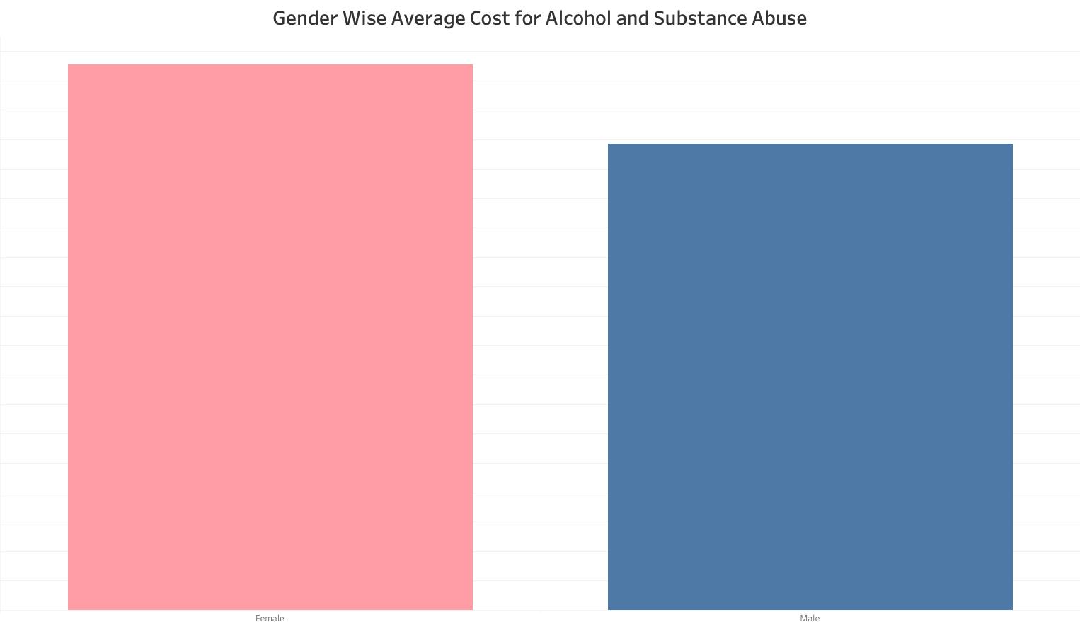
Socio-Economic Status, Alcohol and Substance Use in Children
Gender Disparity: Females charged more than males, especially in the Midwest and Northeast.
Recommendation:
Subsidized Care for Women: Programs similar to those in some European countries, offering additional subsidies for women, especially with dependents, for equal treatment access.

Slide 14
Socio-Economic Status (SES), Alcohol & Substance Use in Children
Alcohol and Substance Abuse with respect to Income quartiles
Smoking:
26.7% in the bottom income quartile smoke, compared to 16.5% in the top.
Alcohol and Marijuana Use:
75.8% in top income quartile drink alcohol vs. 51.0% in bottom.
28.8% in top quartile engage in heavy episodic drinking.
39.1% in top income quartile use marijuana.
Recommendations :
Tailored Prevention Programs: Focus on smoking in lower SES areas and alcohol/marijuana use in higher SES regions.
Parental Engagement: Involve parents, especially in higher SES communities, to mitigate substance use.
Source:- https://www.ncbi.nlm.nih.gov/pmc/articles/PMC3410945/

Slide 15
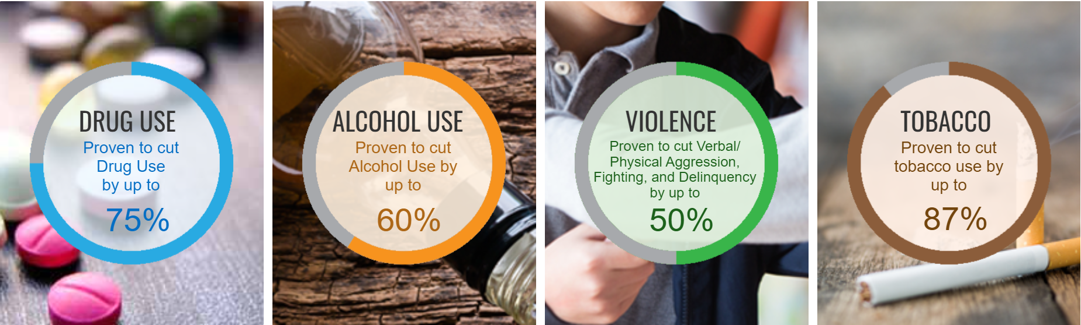
School-based drug abuse prevention programs
Botvin's LifeSkills training
Based on more than 40 years of peer reviewed scientific research. LST is effective universally, across diverse populations and settings.
Notes:
Sources: (1) Journal of Behavioral Medicine (1983), (2) Journal of Studies on Alcohol (1984), (3) Journal of Consulting and Clinical Psychology (1990), (4) Journal of the American Medical Association (1995), and (5) Archives of Pediatric & Adolescent Medicine (2006).
https://www.ncbi.nlm.nih.gov/pmc/articles/PMC2822092/
https://www.lifeskillstraining.com/

Slide 16
Cost Benefit Analysis of Botvin’s LifeSkill Training
Overall US under 18 population- 73 Million
Philadelphia students under 18 population- 118,053 (0.16% of US under 18 population)
Streamlining billing process will save around $504 Billion
Botvin program cost per student- $235
Cost to enroll Philadelphia under 18 children- $28 Million
This is less than 1% of the savings that could be used to enroll students in Philadelphia
There is an another program called project Towards No Drug Abuse, which is also proved to be successful.

Slide 17
School-based drug abuse prevention programs
Project TND (Towards No Drug Abuse)
Selected (for members of at-risk groups)
seven research trials and over 8,600 youth participants, to date, across ethnicities
Evidence of Effectiveness
25% decrease in hard drug use (one-year follow-up).
7-12% reduction in alcohol use for prior users.
27% drop in cigarette use (one year), 50% (two years).
22% decrease in marijuana use (one year), significant reduction in hard drug use (two years)

Slide 18
References
https://www.nichd.nih.gov/health/topics/infant-mortality/topicinfo/reduce-risk
https://www.urmc.rochester.edu/encyclopedia/content.aspx?contenttypeid=90&contentid=p02382#:~:text=Regular%20prenatal%20care%20is%20the,a%20healthy%20diet%20during%20pregnancy
https://www.vox.com/2021/6/7/22522479/medicaid-health-insurance-doctors-billing-research
https://www.hsph.harvard.edu/news/press-releases/mothers-holding-newborns-skin-to-skin-linked-with-lower-death-risk/
https://minorityhealth.hhs.gov/infant-mortality-and-african-americans
https://www.europarl.europa.eu/doceo/document/A-9-2022-0189_EN.html
https://www.ohrc.on.ca/en/race-policy-dialogue-papers/racial-inequality-access-health-care-services
https://store.samhsa.gov/sites/default/files/SAMHSA_Digital_Download/pep22-06-01-006.pdf
https://humanrights.gov.au/our-work/employers/racial-discrimination
https://humanrights.gov.au/sites/default/files/document/publication/Conference%20Papers_Publication%20layout%20Final_0.pdf
https://www.thelancet.com/journals/lancet/article/PIIS0140-6736(17)31280-1/fulltext
https://www.europarl.europa.eu/workingpapers/saco/pdf/101_en.pdf
https://www.milbank.org/quarterly/opinions/the-public-private-option-in-germany-and-australia-lessons-for-the-united-states/
https://www.government.nl/topics/health-insurance/standard-health-insurance
https://www.oecd.org/netherlands/34081266.pdf
https://www.ncbi.nlm.nih.gov/pmc/articles/PMC3410945/
https://pubmed.ncbi.nlm.nih.gov/11921317/
https://www.cpr.org/2019/12/06/women-who-stop-smoking-while-pregnant-not-only-benefit-their-babies-they-save-colorado-millions-this-state-program-helps-them-quit/
https://www.americanprogress.org/article/excess-administrative-costs-burden-u-s-health-care-system/
https://www.ncbi.nlm.nih.gov/pmc/articles/PMC4195156/
https://www.ncbi.nlm.nih.gov/pmc/articles/PMC7067068/
https://www.ncbi.nlm.nih.gov/pmc/articles/PMC4283267/
https://www.ncbi.nlm.nih.gov/pmc/articles/PMC2822092/
https://www.lifeskillstraining.com/
https://www.ncbi.nlm.nih.gov/pmc/articles/PMC2916744/
https://tnd.usc.edu/
https://www.ncbi.nlm.nih.gov/pmc/articles/PMC5303131/

Slide 19
Thank You.​

